Slide 1
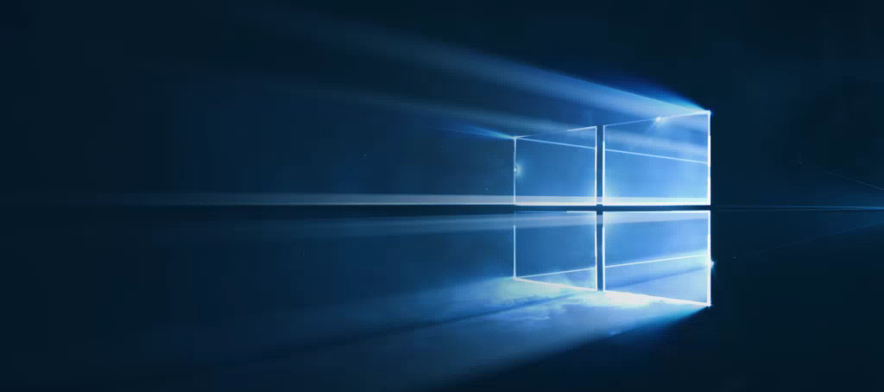
Windows
Camp //Labs
2015

Slide 2




Windows Camp //Labs
#wincamplabs

Slide 3
Разработка приложений на основе веб-технологий
04
Константин Кичинский
Технологический евангелист, Microsoft

Slide 4
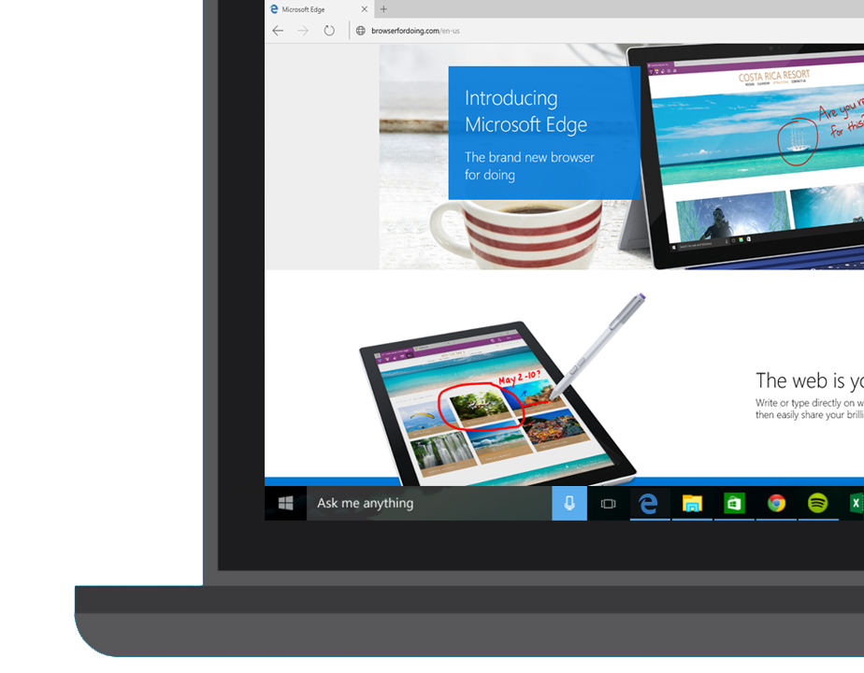
Microsoft Edge and Web App Platform Windows 10 Developer Workshop

Slide 5
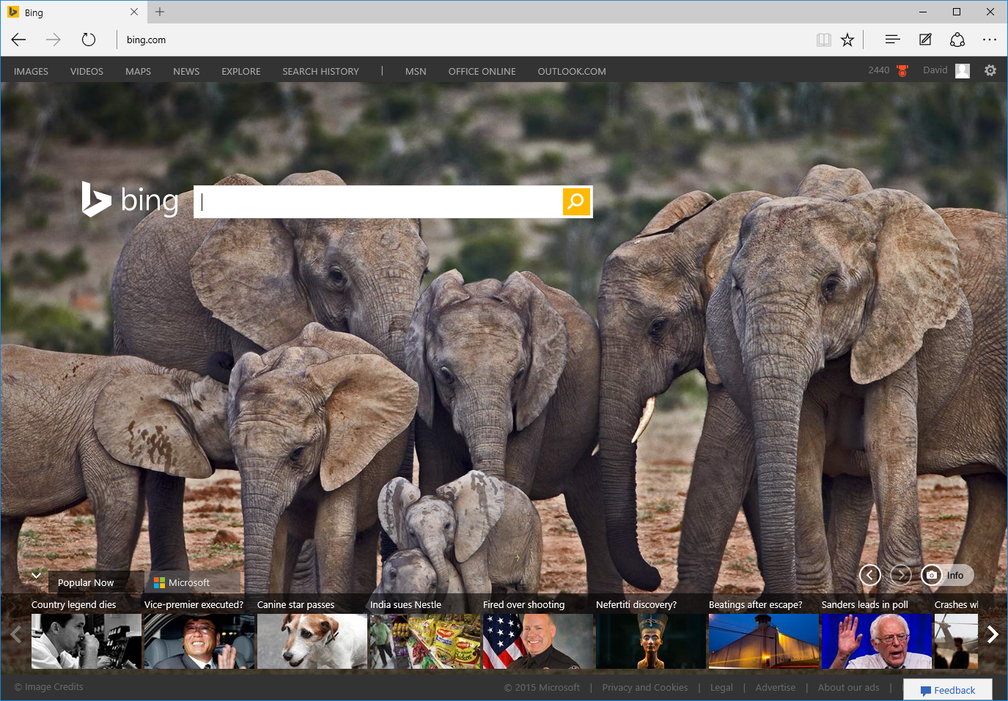
Введение в Microsoft Edge
Notes:
In Windows 10, we’ve introduced a brand new browser called Microsoft Edge.

Slide 6

«Всегда свежий»
EdgeHTML
Chakra
EdgeHTML
Chakra
Notes:
The big difference with Microsoft Edge is that it has an engine that is always up to date.
IE11 will still be available for those cases where you need to access legacy web content, or for sites that use plug-ins such as ActiveX or Silverlight.
But for the modern web, for the most up to date features such as HTML5, ECMAScript 6 and CSS3 or 4, you’ll want to use Edge.
And we will always keep it up to date – we call it ‘Evergreen’.
So this makes things easier for the web developer. If you want to develop for the web, you just need to target the latest versions of Firefox, Chrome, Opera and Edge

Slide 7
Производительность
Notes:
In Edge, we did tremendous work on the Chakra JavaScript engine which yielded tremendous performance.
Here is how EdgeHTML performs on two leading web benchmarks:
<click>
On the JetStream benchmark created by Apple, which simulates complex web applications, EdgeHTML is over 1.5x faster than IE11.
<click>
Beyond that, it is also ahead of the latest 64-bit browsers.

Slide 8
Производительность
Notes:
Next on the Octane benchmark, created by Google, Edge is over twice as fast as IE11
<click>
And again, Edge, leapfrogs into the lead ahead of other 64-bit browsers.
Our work is not done, but we feel great that Edge will provide industry leading performance out of the gate.

Slide 9




Строки юзер-агентов (UA)
Mozilla/5.0 (Windows NT 10.0; WOW64; rv:35.0) Gecko/20100101 Firefox/35.0
Mozilla/5.0 (Macintosh; Intel Mac OS X 10_10_1) AppleWebKit/600.1.25 (KHTML, like Gecko) Version/8.0 Safari/600.1.25
Mozilla/5.0 (Windows NT 10.0; WOW64) AppleWebKit/537.36 (KHTML, like Gecko) Chrome/40.0.2214.93 Safari/537.36
Mozilla/5.0 (Windows NT 10.0; WOW64) AppleWebKit/537.36 (KHTML, like Gecko) Chrome/39.0.2171.71 Safari/537.36 Edge/12.0
Notes:
Any web browser must identify itself to the server and it does this by sending its User Agent string with evey request to download a page. On the other side, the server looks at the user agent string, identifies the type of web browser being used and the OS where it is hosted, and makes decisions based on that on which version of the web page content to send back.
That isn’t how the web should work! The server should just send back the best content regardless of who is asking for the content.
It is the responsibility of the web developer to add JavaScript to do what we call ‘feature testing’ to for example, see if WebAudio is supported by the requestor and if it is, sending back the WebAudio content. But many websites today are ‘sniffing’ the user agent string and using that to decide what content to send back.
Because of this, in Microsoft Edge we decided to change our User Agent string and as you can see, it looks like Chrome. We do this because we want to make sure we receive the modern content, the best content available – because Edge is built for the modern web and can handle it.
This isn’t a new idea – in the slide, all the parts shown in red are ‘lies’! None of the modern browsers are Mozilla 5.0. Chrome is not AppleWebKit or Safari. Everyone has played this game at some point or other.
The takeaway is that if you are using Microsoft Edge, you will receive the latest content.

Slide 10
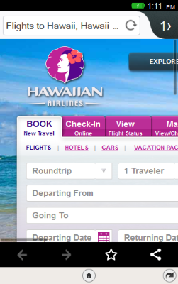
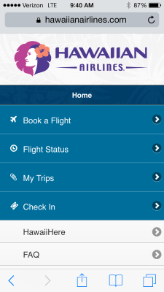


Notes:
By doing that, we move from this state: where only the iPhone version in the middle is receiving the correct content. By sniffing the user agent string, the server has detected that the browser on the right is IE Mobile, but in the absence of a specific mobile friendly site, is sending it the desktop version of the page.

Slide 11
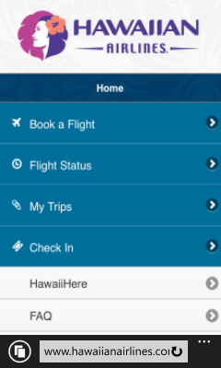

Notes:
But now with Microsoft Edge and because we are playing the user agent game, we are receiving the right content, the best mobile optimized website.

Slide 12

Microsoft EdgeHTML
Microsoft Edge
JS Symbols
ES6 Numbers Built-Ins
DOM L3 XPath
Rest parameters
4200+ улучшений совместимости
ES6 Template Strings
Arrow function
asm.js
JS iterators
<img srcset>
Web Audio API
ES6 classes
GamePad API
Content Security Policy
Video tracks
ES6 Promises
Selection API
ES6 Math Built-Ins
HTTP Strict Transport Security
Touch Events
Media Queries L4 Interaction Media
ES6 String Built-Ins
ES6 WeakSet
getUserMedia()
ES6 Spread
preserve-3d
ES6 Proxies
ES6 Object Built-Ins
HTTP/2
WAV audio
HTTP Live Streaming
Date <input> types
Motion JPEG
Generators
Notes:
But it’s not just about compatibility, it’s also about new features.
We did a ton of work on new features: more than 4200 interoperability improvements. We’ve added features such as HTTP/2, EcmaScript 6 and many, many more – all the features that web developers have been asking for the most.

Slide 13
Веб-платформа Windows
Notes:
Now, talking about the Web platform.
The Web platform we have for web developers today is built off the same technologies we have in Edge.
In Windows 10, whenever you are using a web component, whether that’s inside of Edge, or inside a hosted web app or a packaged app, it’s all using that same rendering engine.

Slide 14
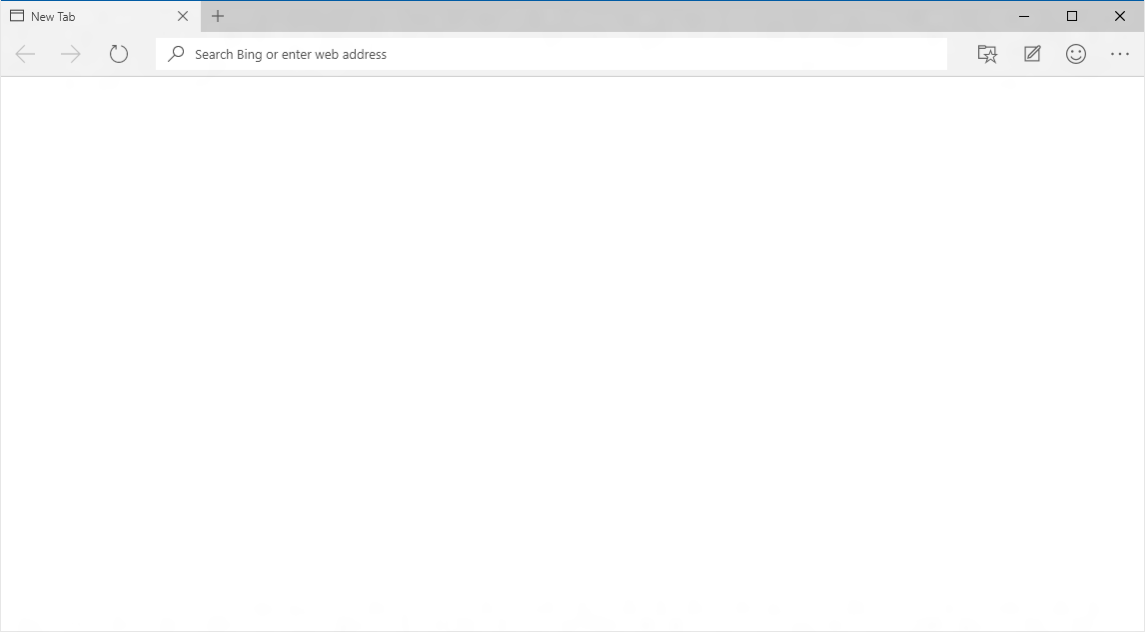
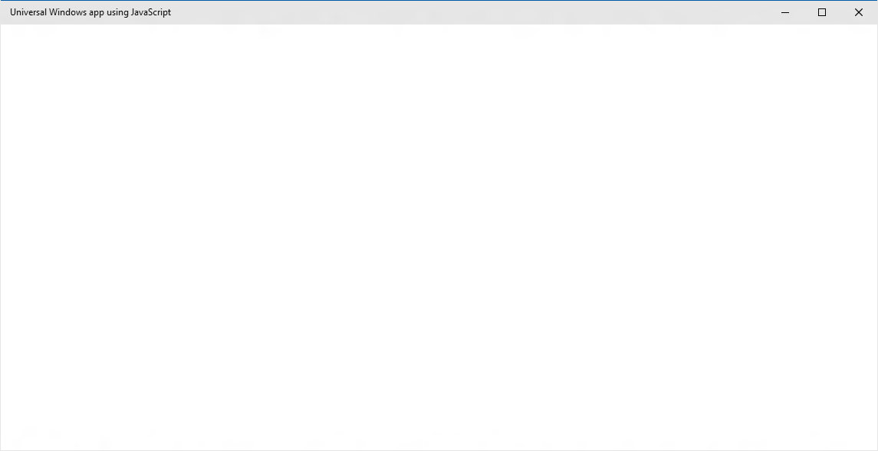
EdgeHTML.dll
Chakra
Notes:
So this is a window in Edge today.
<Click>
It’s running off the EdgeHTML rendering engine – so that’s the new rendering engine that has all of those new features, all of those interoperability fixes inside it
<Click>
and then we also have the new Chakra engine, which runs JavaScript blazingly fast.
<Click>
So those engines are the same things we have inside a JavaScript Windows app. The great thing about that is you know that if your code runs inside of Edge, it’ll run inside the app.
So what this means for a web developer is that if you’re writing your code for the web, you can easily transition that code into the app space. In Windows 10, we’re bringing those things much closer together, blurring the distinction between apps and the web.

Slide 15
Упакованный контент
Автономность
Хостящийся контент
Свежесть
WebView
Notes:
So there’s a few different ways you can present your code inside Windows 10.
First of all, you can package your content. This is something we introduced to Windows in Windows 9, where you can take your JavaScript, your HTML and your CSS and basically put that inside a zip package and that’s what the user downloads from the store and installs onto their machine.
So it’s generally offline first – everything is running locally off the users’ machine. It’s making service calls for your content.
<Click>
We also have a new model in Windows 10 called the ‘Hosted Web App’ – you may also hear it referred to by its code name which is Project Westminster. This is a way of taking the code that is living on your web server and to turn that into an application.
So this is better than a packaged app in many ways. Packaged apps are great if you’ve got a single page site and you can package that up and have it work offline, but there are many saites out there written on the backend using technologies such as nodeJS or PHP – and now you can take those websites and turn them into an application.
<Click>
The third thing you can do is to mix it up – have some content local, have some on the server. This is where the WebView becomes really useful. You can direct it to show local content or remote content, and allows you to really mix it up.

Slide 16
Упакованный контент
Автономность
Notes:
So let’s talk about packaged apps first.

Slide 17
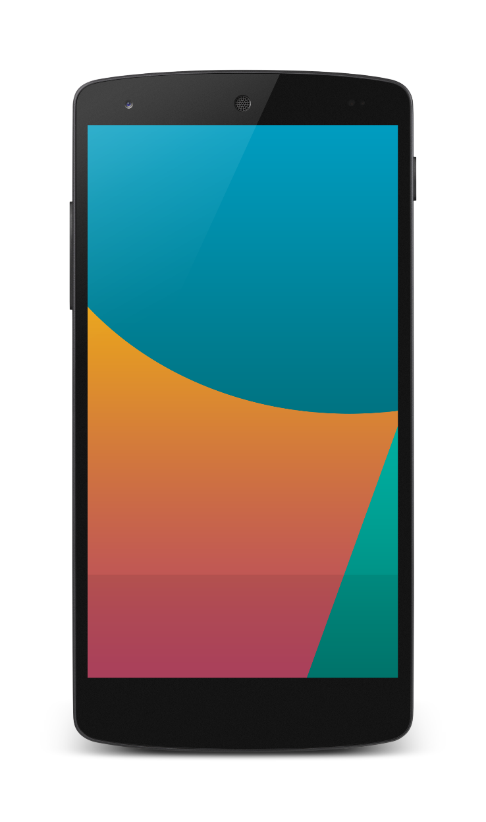


Упакованные приложения
Разработка под iOS, Android и Windows
Почти 100% общего кода
Отладка на устройства и в эмуляторе
Использование любимых библиотек на JavaScript
Поддержка offline-работы
Notes:
The really great tooling features we have inside of Visual Studio is around Apache Cordova.
Apache Cordova is a way for you to build these packaged JavaScript apps and to deploy them cross-platform. So this is not a solution just for Windows – Cordova apps run on iOS and Android and other platforms as well.
Visual Studio 2015 now supports Apache Cordova app development as a first-class app dev framework – it’s the very best IDE for building Cordova apps, with great features such as a blazingly fast Android emulator.

Slide 18
WebView
Notes:
Next thing to talk about is the WebView. It’s a very handy tool and we find that a large proportion of the apps inside the Windows Store use a WebView for some reason or another. You can use it inside a JavaScript app or inside a XAML app to display some web content.

Slide 19
Элемент управления WebView
Использует свежий движок из Edge
Улучшенные производительность и отзывчивость
Улучшенное взаимодействие приложения и WebView
Разрешен доступ к Windows Runtime
Notes:
We have a number of great new features in the WebView in Windows 10. There’s a number of performance improvements, but major enhancements are around the ways that your JavaScript can call code modules written in C# or C++, where you no longer have to use the old windows notify techniques.
There is also easy access from your JavaScript running in a WebView to call Windows Runtime APIs for doing great things like Live Tiles or Toasts.

Slide 20
Хостящийся контент
Свежесть
Notes:
So now let’s talk about a Hosted Web App.
With this, your app is always up to date because your content is hosted on the web server.

Slide 21
Microsoft Edge
Хостящиеся веб-приложения
Перенос веб-опыта в Windows Store
Переиспользование сделанных инвестиций и текущего процесса разработки
Полный доступ к Universal API, включая
Плитки, уведомления, камера, список контактов, календарь и др.
.appx
HTML
CSS
JS
Universal Windows Platform
Notes:
This is how a Hosted Web App works: when a user fires up your app, it goes out to your web server and pulls the content down to execute inside of your app context. So it’s just like a web browser – your own little web browser just for your app content.
You don’t have to change your code, it runs just the same as it does in Microsoft Edge. And it is a Store application, so it has its own memory footprint and its own cache that it doesn’t have to share with other applications, it’s sandboxed and secure just like other Store applications, and the great thing is that when your code is executing in that safe environment, we can give your code access to all the Windows Runtime APIs.

Slide 22
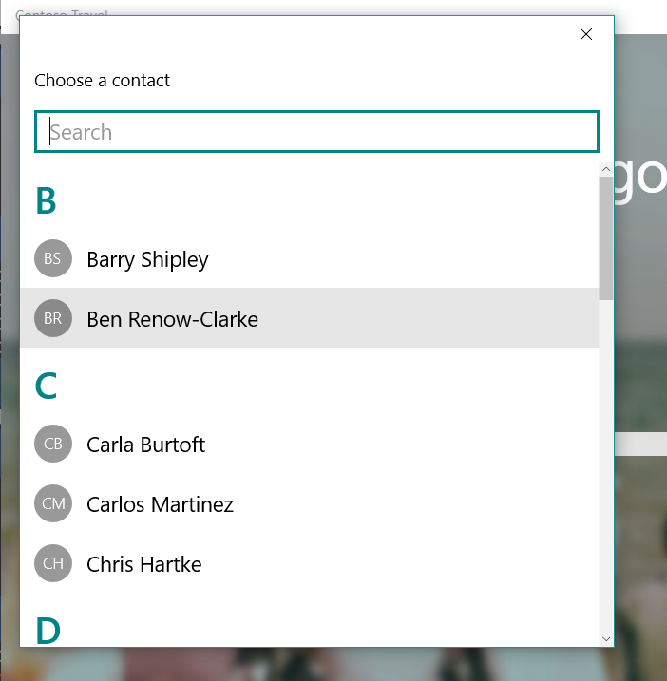
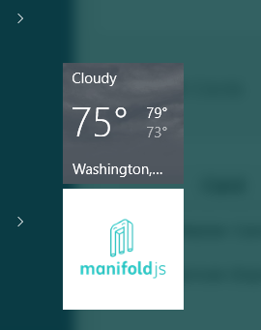
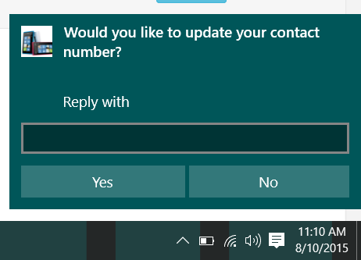
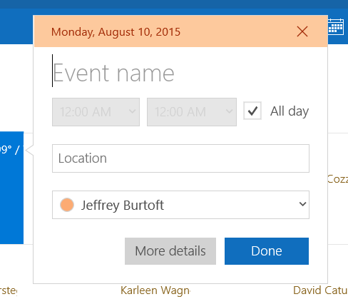
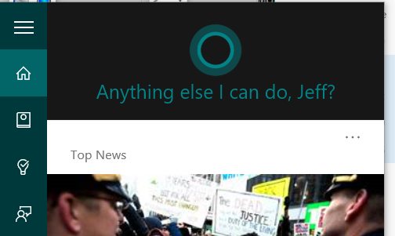
Windows APIs
Notes:
So your website code can access toast notifications, contacts, calendar, camera and Cortana to mention just a few…
So for web developers who have been asking over the years for access to this API or that API – now, inside of a hosted web app, you can have access to all of those.

Slide 23
Lab: Hosted Web Apps
Notes:
Exercise 2 of the Hosted Web Apps lab

Slide 24
W3C Standard
{
"name": "Super Web App",
"short_name": "SuperWA",
"start_url": "http://www.example.com",
"icons": [
{
"src": "tiny.png",
"sizes": "70x70"
},
{
"src": "square.png",
"sizes": "150x150"
},
{
"src": "apple-touch-icon-72x72-precomposed.png",
"sizes": "72x72"
},
{
"src": "niceicon.png",
"sizes": "128x128"
}
],
"display": "standalone",
"orientation": "landscape"
}
Manifest for Web Apps
http://w3c.github.io/manifest/

Slide 25
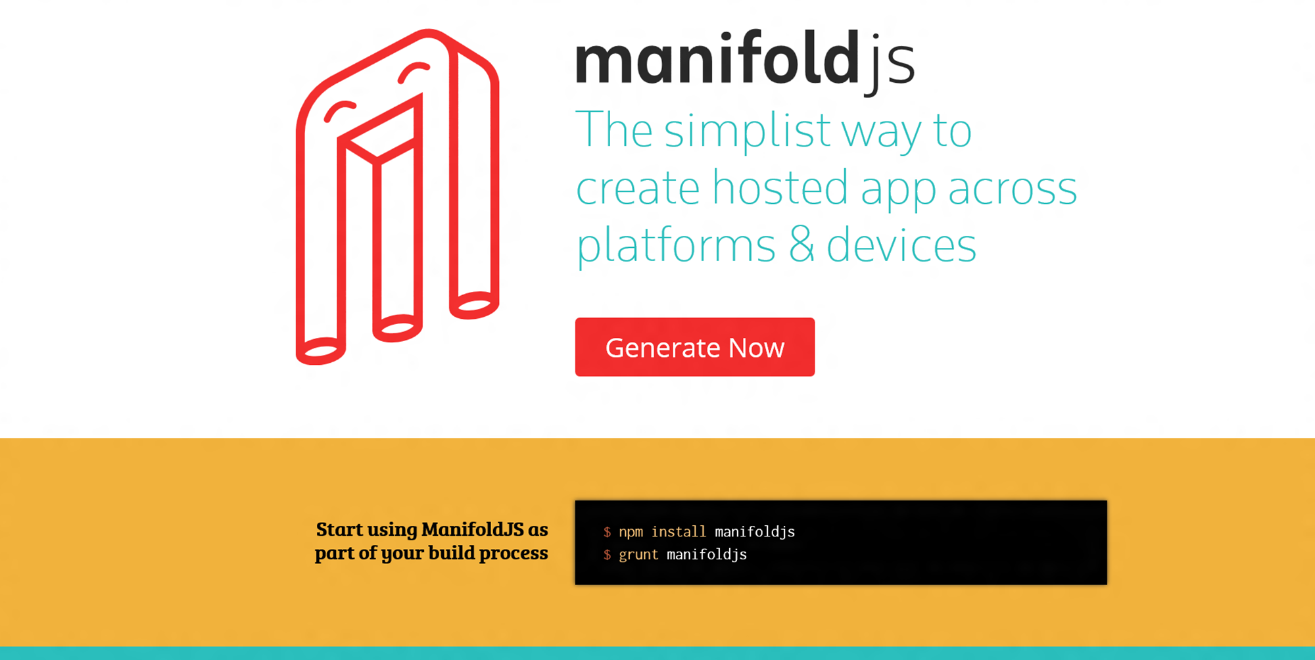

Slide 26
DEMO ManifoldJS

